Slide 1
The Annual Fund
Of the
Rotary Foundation
Presentation
District 6200
9/24/16

Slide 2
DOING GOOD IN THE WORLD
OUR FOUNDATION’S
MOTTO

Slide 3
Who or What is The Rotary Foundation ?
Rotary Foundation is a charity
that supports the efforts of Rotary International
to achieve world understanding and peace
through international humanitarian, education, and cultural exchange programs.
Charity Navigator – 4 Star – 96.31 Rating
2015 Rating
2016 Rating – 100 Rating

Slide 4
The Rotary Foundation Funds
Annual Fund
Endowment Fund
Polio
Notes:
What is the Rotary Foundation?
The Foundation uses a variety of funds to support the mission of Rotary. The 3 most well known
the Annual Fund- which supports the projects and programs of today.
The Endowment Fund- supporting projects and programs for tomorrow.
Polio- set up for the global eradication of Polio.
Question- What are some service projects that your club has done in the past
How many of you have used DDF or matching or global grants?

Slide 5
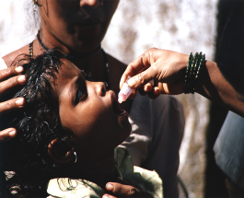
Three Needs, Three Ways of Giving
End Polio Now
Checking Account
To Support Today
Savings Account
To Secure Tomorrow

Slide 6
Foundation Funding
Contributions
SHARE
System
Contributions
Earnings

Slide 7
What is The Rotary Foundation?
Annual Fund
Notes:
What is the Rotary Foundation?
The Foundation is the charitable arm of Rotary International that is supported solely by voluntary contributions from Rotarians and friends of the Foundation who share its vision of a better world.
The Foundation uses a variety of funds to support the mission of Rotary. One of the 3 most well known
the Annual Fund- which supports the projects and programs of today.
Question- What are some service projects that your club has done in the past
How many of you have used DDF or matching or global grants?

Slide 8
HOW WE FUND PROGRAMS
50% District Designated Funds (DDF)
50% World Fund
The Annual Fund-SHARE System
Notes:
Fifty percent (50%) of all Annual Fund – SHARE contributions come back to our district through District Designated Funds (DDF) in three years to spend on educational and humanitarian activities chosen by you; even grants that may be used for projects in our local community.
The other 50% goes to the World Fund and is used to fund other Foundation programs in which we can participate, and is the source of matching funds we receive from our Foundation to implement some of our international projects.
So the funds we have access to this year are a result of our contributions three years ago.
New Annual Fund Giving Opportunities: Rotarians and friends of Rotary can also direct Annual Fund contributions to any of the Foundation’s six areas of focus:
Peace and conflict prevention/resolution
Disease prevention and treatment
Water and sanitation
Maternal and child health
Basic education and literacy
Economic and community development
These additional opportunities are intended to attract new donors, including non-Rotarians and other organizations; Contributions directed to any of the six areas of focus are included toward a club’s annual giving goal and per capital calculations. Likewise, they are eligible for all APF recognition opportunities.
Areas of focus designated contributions are not included in a district’s SHARE calculation and do not generate any DDF.
Because SHARE contributions are the primary source of funding for Foundation programs, SHARE-designated contributions from every Rotarian, every year remain crucial.

Slide 9
PAUL HARRIS FELLOW
ANNUAL FUND
MULTIPLE PAUL HARRIS FELLOW
PAUL HARRIS SOCIETY
MAJOR DONOR
ARCH KLUMPH SOCIETY
Notes:
Here are the programs that the Annual Fund supports.

Slide 10
EVERY ROTARIAN EVERY YEAR
100% Member Participation
Is your goal
Notes:
The Rotary Foundation
-Addresses all of the greatest educational and humanitarian needs
-Its world reach is greater than the United Nations
-We can go where many other groups cannot
The Annual Fund is the primary source of funding for the programs of The Rotary Foundation. The Annual Fund is the cornerstone for these programs; for the beneficiaries, and why we give. It is for the stories these programs permit us to tell.
For us to continue doing so much good in the world, it is necessary for Every Rotarian to participate in the programs and to support our Foundation Every Year.
If Rotary is to be there to:
Teach children to read, build wells, feed the hungry, care for the sick, shelter the poor; then Every Rotarian is invited to support the Annual Fund with a personal contribution, Every Year.
Check if your Rotary club has a club fundraising goal for the Annual Fund this year, and help achieve it with your personal gift.
Th

Slide 11
RECURRING GIVING THROUGH
Rotary Direct
Rotary’s recurring giving program
Give monthly, quarterly or annually
Enroll at: www.rotary.org/contribute
Notes:
Rotary Direct, Rotary’s recurring giving program, is a great way to join the PHS in a safe, secure and easy way. A recurring contribution is an arrangement made through the Foundation to charge a preferred credit or debit card at an amount and frequency most convenient to you. This can be done monthly, quarterly or even annually....
Perhaps one of the best parts of Rotary Direct is that it makes your bank statement a better read. When looking at what you spent you will see nestled in between purchase of Starbucks coffee your gift to the Rotary Foundation. You know that that gift is going to provide clean drinking water or bettering your community.
And enrollment can be done online, in 13 currencies, while preserving local tax benefits in most cases. For example, a Canadian Rotarian can donate via www.rotary.org, in Canadian dollars and receive a tax receipt from the Canadian Associate Foundation.
With contributions of US$85/month or $250/quarter Rotarians and friends will be considered a member of the Paul Harris Society and will show up on available reports.
NOTE: Rotary’s website accepts contributions in the following currencies: Argentine Peso, Australia Dollar AUD, Canadian Dollar CAD, DKK Denmark, EURO, Japanese Yen JPY, New Zealand Dollar NZD, Norway NOK, South African Rand ZAR, Sweden SEK, Swiss Franc CHF, Great Britain Pound GBP, United States Dollar USD.
11

Slide 12
Goal Setting on Rotary Club Central
My Rotary
Per capita giving over $100
Notes:
A key to promoting and encouraging contributions is by setting goals for your club.
Clubs that set a goal had a per capita giving of just over $100- approximately 110% higher than clubs that did not set a goal
Roughly 33% of clubs that did not set a goal ended up being non-contributing clubs at the end of that Rotary Year
There is a great new tool off of the rotary.org website —called Rotary Club Central that allows you (and other club officers) to set goals for Foundation giving during your year. There are areas within Rotary Club Central that will allow you and your club to think about contributions in a new way. The tool allows you to review historical information, think about members that have the capacity and propensity to make larger contributions and pursue sustained growth in giving that your club can achieve year after year.
It is recommended that all Foundation giving goals are entered by 1 May so that the Trustees can use that information to set and announce the 2013-14 world-wide Annual Giving goal at the Convention in Lisbon! [Note: We will take goals year-round so if that is not attainable encourage goal submission regardless of the recommended May deadline]

Slide 13
Club Recognition
Every Rotarian Every Year Club
100% Sustaining Member Club
Top 3 Club Per Capita Clubs

Slide 14
Club Recognition Opportunities / Club Banner Recognition
ANNUAL FUND – New Recognition Program
100% Foundation Giving
Every member contributes at least US $25 to any fund in The Rotary Foundation
Rotary club achieves a per capita minimum of $100
100% Every Rotarian Every Year
Every member contributes at least US $25 to the Annual Fund
Rotary club achieves a per capita minimum of $100
Top Three Per Capita in Annual Fund Giving
Given to top three Annual Giving per capita clubs in the district
Clubs must achieve a minimum US $50 per capita
100% Paul Harris Fellow Club
Every member is a Paul Harris Fellow
Awarded one time but the intent is that the club will maintain this status in future years
100% Paul Harris Society Club
Every active (dues-paying) member has contributed a minimum of $1,000 outright to the Annual Fund, PolioPlus Fund, or an approved global grant during a given Rotary year
Notes:
100% Foundation Giving
Every member contributes at least US $25 to any fund in The Rotary Foundation
Rotary club achieves a per capita minimum of $100
100% Every Rotarian Every Year
Every member contributes at least US $25 to the Annual Fund
Rotary club achieves a per capita minimum of $100
Top Three Per Capita in Annual Fund Giving
Given to top three Annual Giving per capita clubs in the district
Clubs must achieve a minimum US $50 per capita
100% Paul Harris Fellow Club
Every member is a Paul Harris Fellow
Awarded one time but the intent is that the club will maintain this status in future years
100% Paul Harris Society Club
Every active (dues-paying) member has contributed a minimum of $1,000 outright to the Annual Fund, PolioPlus Fund, or an approved global grant during a given Rotary year

Slide 15
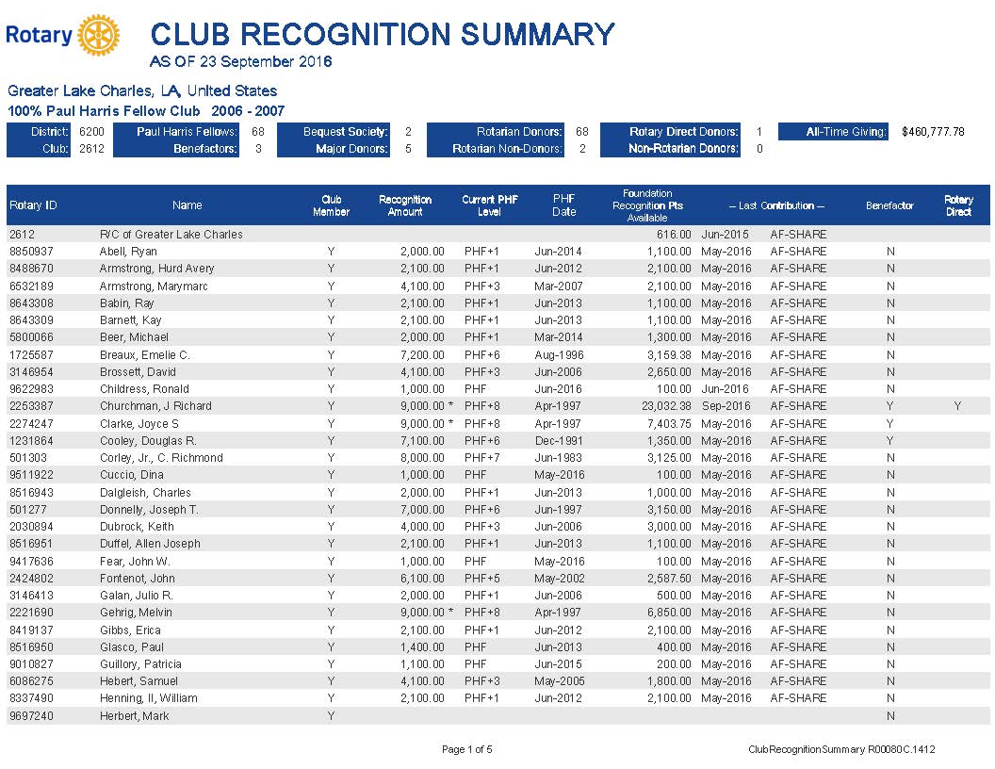
District 6200 Session #3
Annual Fund
$100 per Rotarian (Sustaining Member)

Slide 16
District 6200 Session #3
Annual Fund
$100 per Rotarian (Sustaining Member)

Slide 17
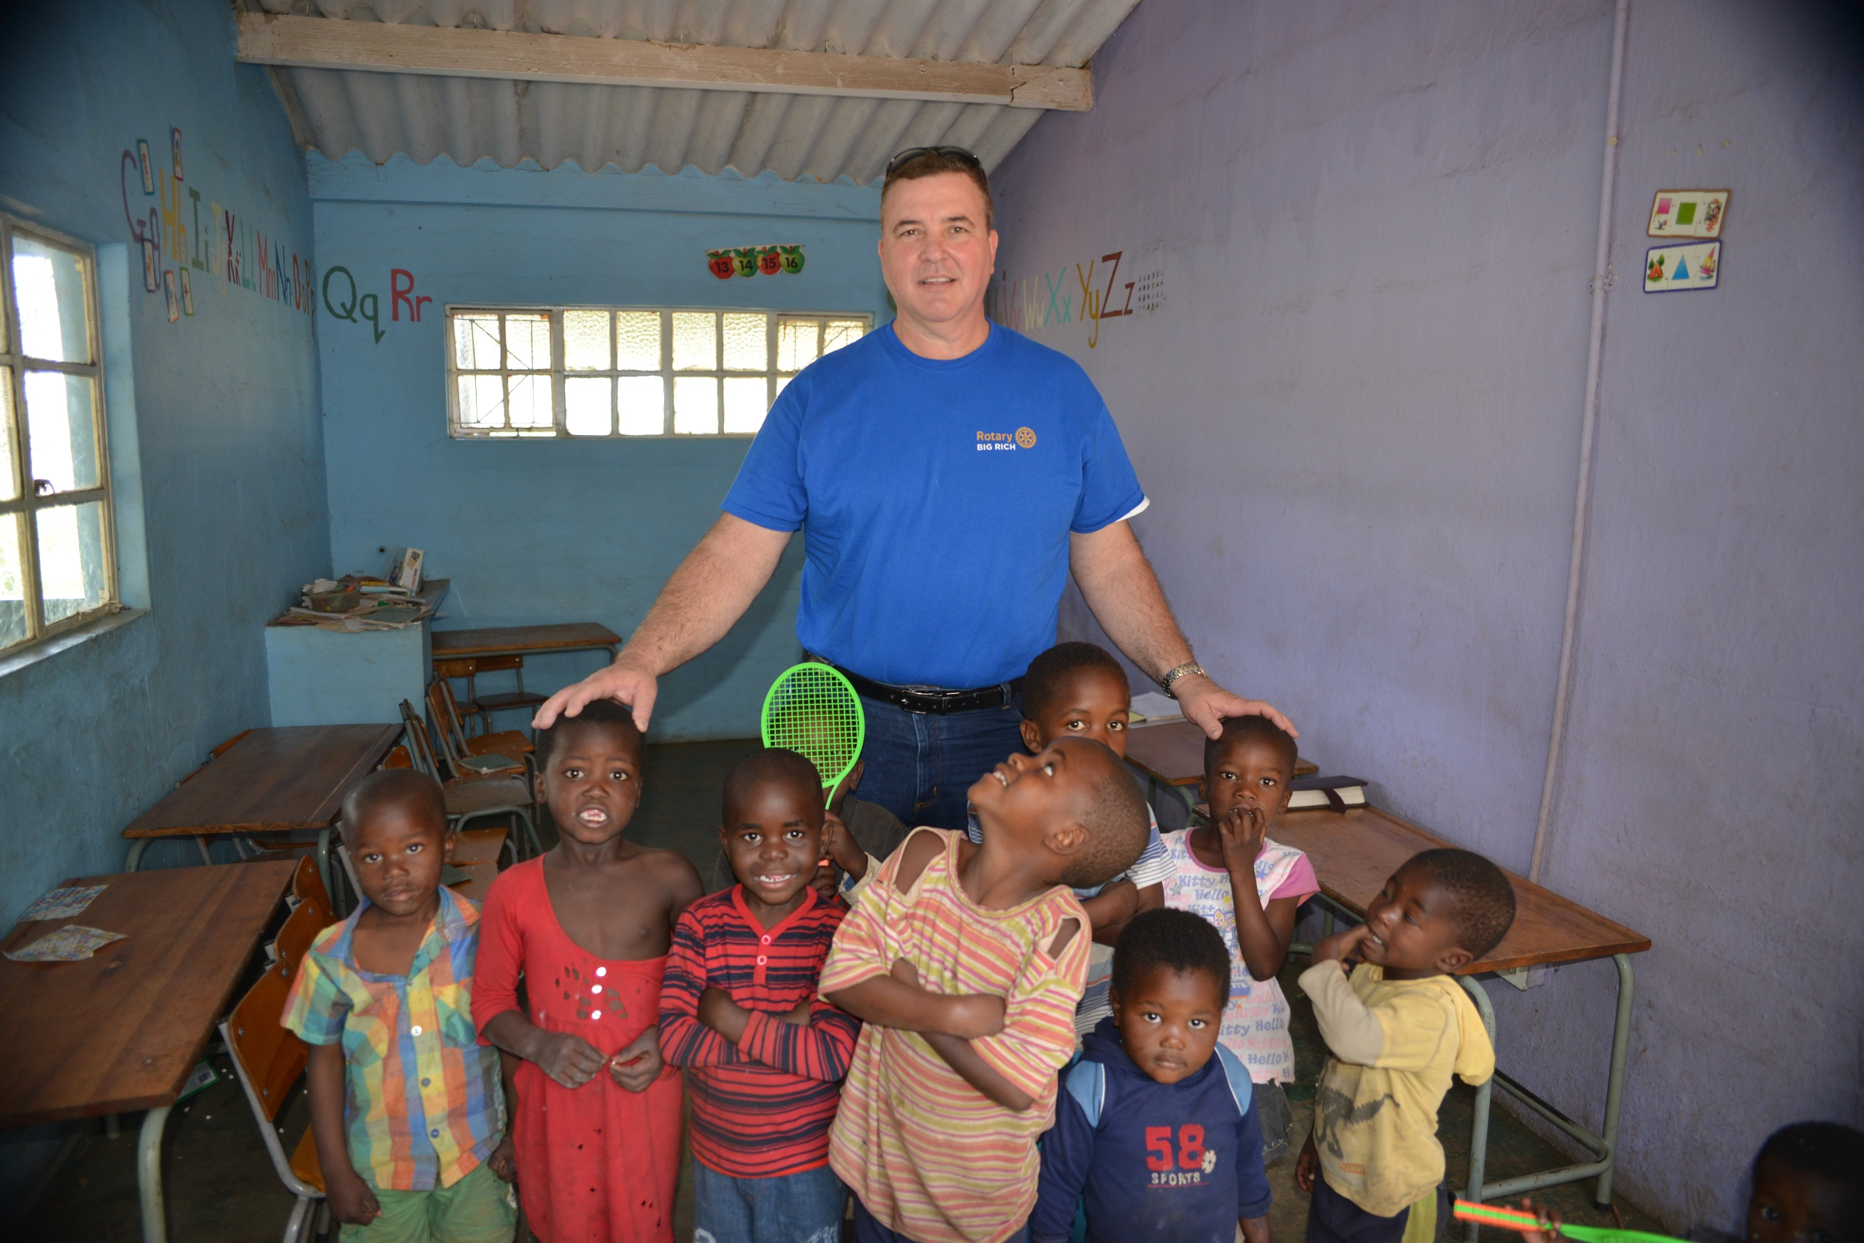

Slide 18
Rotary Serving Humanity
THANK YOU

